Slide 1
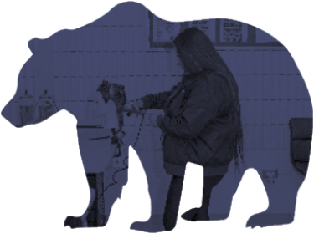
Inclusive
Education
Model
Learning and Innovation
Generosity
Citizenship and Relationships
Capacity-Building Coaching
Belonging
Prof. Learning Communities
Presuming Competence
Collaboration
Place
Participation/Peers
Mental Health and Well-Being
We belong!
I belong!
Inclusion and Cultural Responsiveness
Professional Development
Circle of Courage
Planning For All
Instructional Leadership
Governance and Leadership
SRPSD Priorities
Purpose
Independence
Mastery
Drivers of Professional Excellence
Research
Principles of Inclusion
High-Impact Practices
Click on the text labels to be directed to more details on each of the elements of the Inclusive Education Model

Slide 2
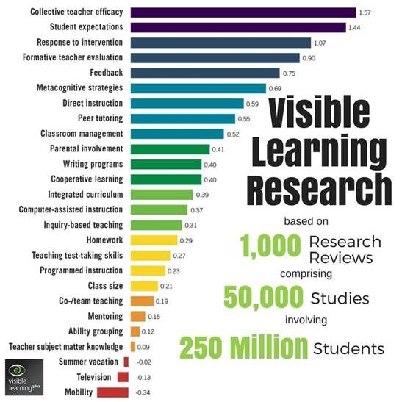
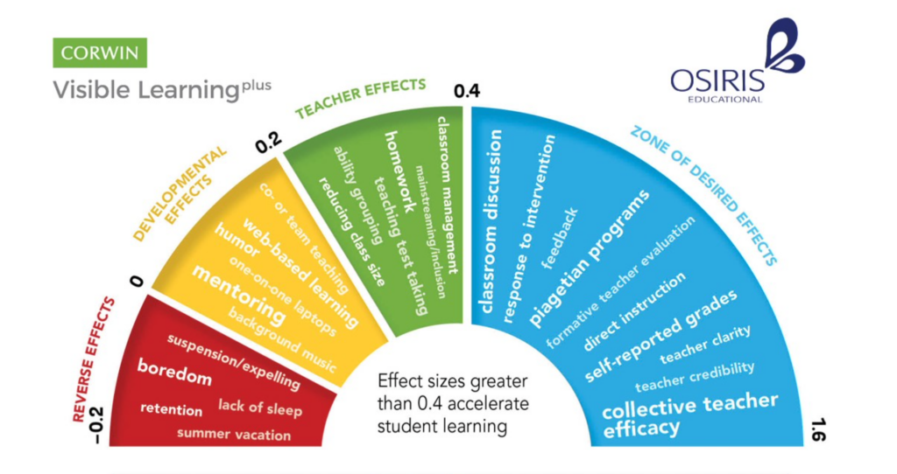
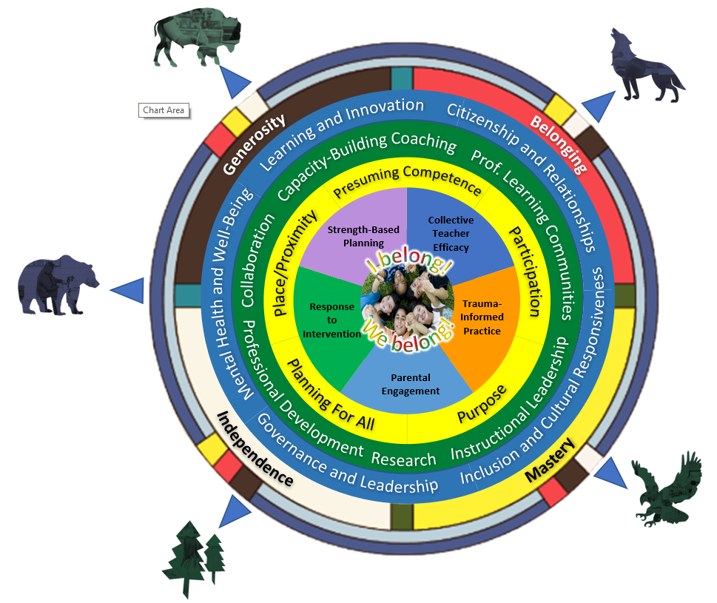
High-Impact Practices
I belong!
We belong!
1.57

Slide 3
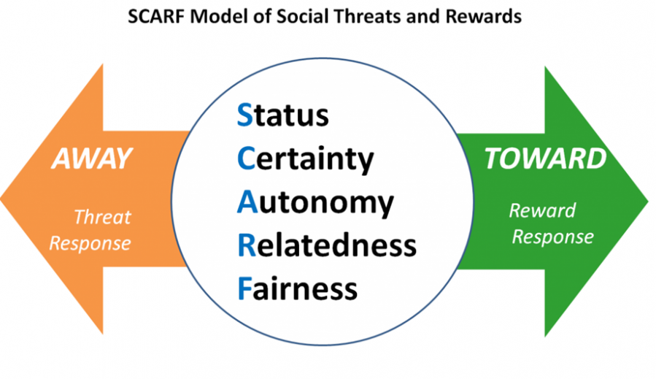
High-Impact Practices
What is Trauma-Informed Practice?
I belong!
We belong!
1.07

Slide 4
High-Impact Practices
School Interrupted
Debbie Pushor Podcast
Webinar with SunWest School Division
Dr. Debbie Pushor
Parent Engagement
I belong!
We belong!
0.50

Slide 5
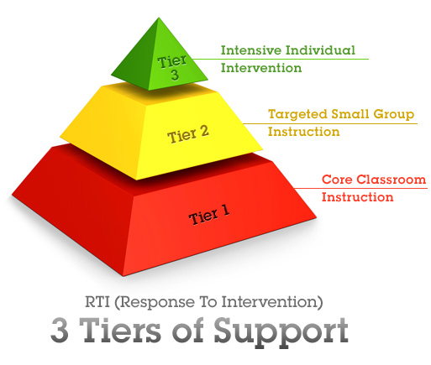
High-Impact Practices
I belong!
We belong!
1.29

Slide 6
High-Impact Practices
I belong!
We belong!
0.93

Slide 7
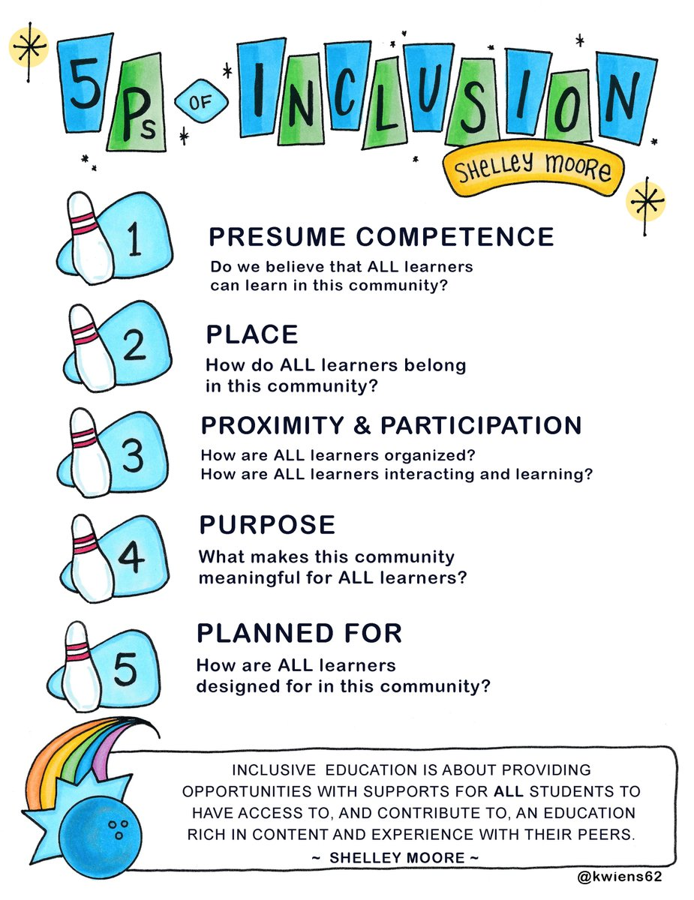
5 Principles of Inclusion
Presuming Competence
Place
I belong!
Participation/Peers
We belong!
Planning For All
Purpose

Slide 8
5 Principles of Inclusion
Presuming Competence
Place
I belong!
Participation/Peers
We belong!
Planning For All
Purpose

Slide 9
5 Principles of Inclusion
Presuming Competence
Place
I belong!
Participation/Peers
We belong!
Planning For All
Purpose

Slide 10
5 Principles of Inclusion
Presuming Competence
Place
I belong!
Participation/Peers
We belong!
Planning For All
Purpose

Slide 11
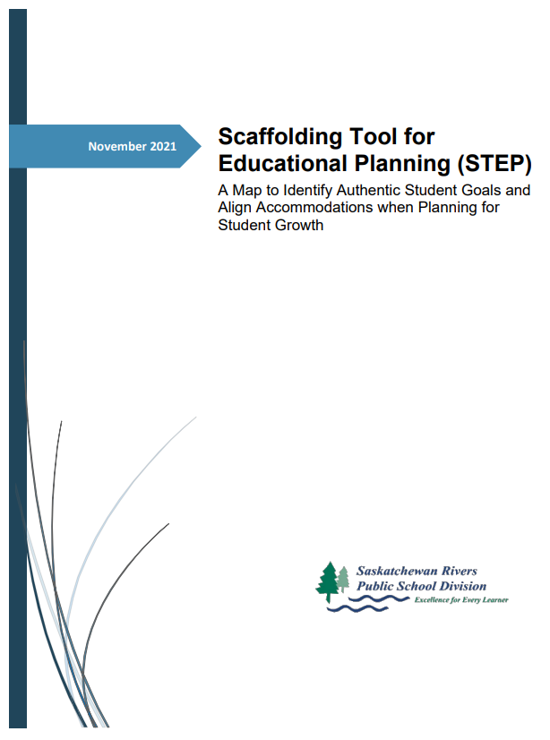
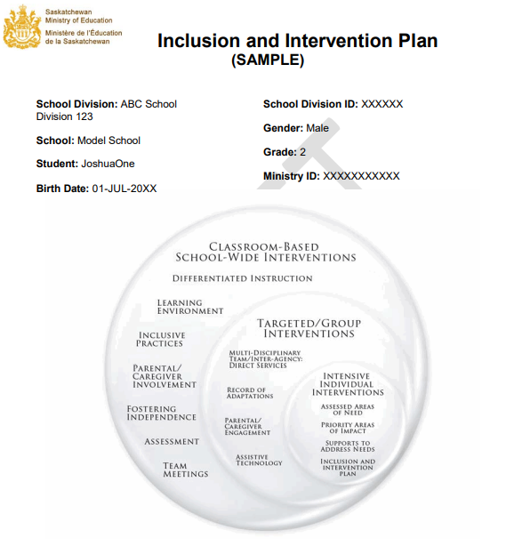
5 Principles of Inclusion
Presuming Competence
Place
I belong!
Participation/Peers
We belong!
Planning For All
Purpose
SRPSD IIP Webpage

Slide 12
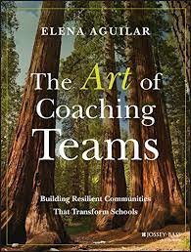
Indigenous Perspectives
Theresa Thorsen
Intensive Supports
Diana Isbister – Cluster 1 Schools
Karen Sinoski – Cluster 2 Schools
Tracy Rouault – Cluster 3 Schools
Mental Health Capacity Building
Dorothy Schluff – Grades 3-6
Carol Lemire – Grades 7-12
Early Learning
Kami Karakochuk
Literacy
Michelle Blais-Court
Kristen Pawliw
Capacity-Building Coaching
Prof. Learning Communities
Collaboration
I belong!
We belong!
SRPSD Capacity-Building Coaching Overview
PowerPoint Presentation
Professional Development
Instructional Leadership
Research
Drivers of Professional Excellence

Slide 13
Drivers of Professional Excellence
Capacity-Building Coaching
Prof. Learning Communities
Collaboration
I belong!
SRPSD EDSBY
Learning Community Groups
We belong!
Professional Development
Instructional Leadership
Research
Excellence For Every Learner Podcast
Ministry of Education
Supporting All Learners Website

Slide 14
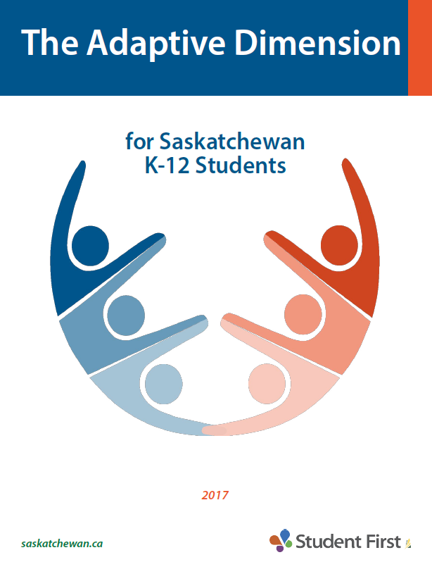
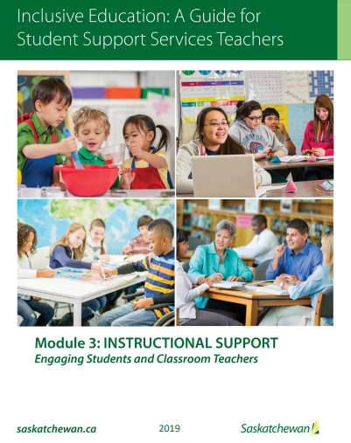
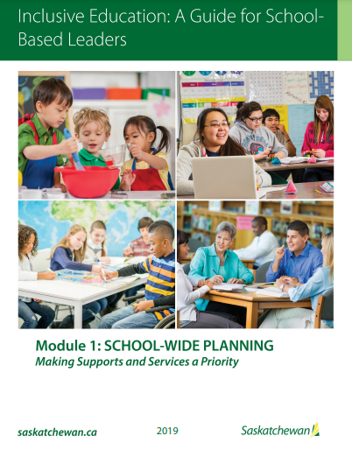
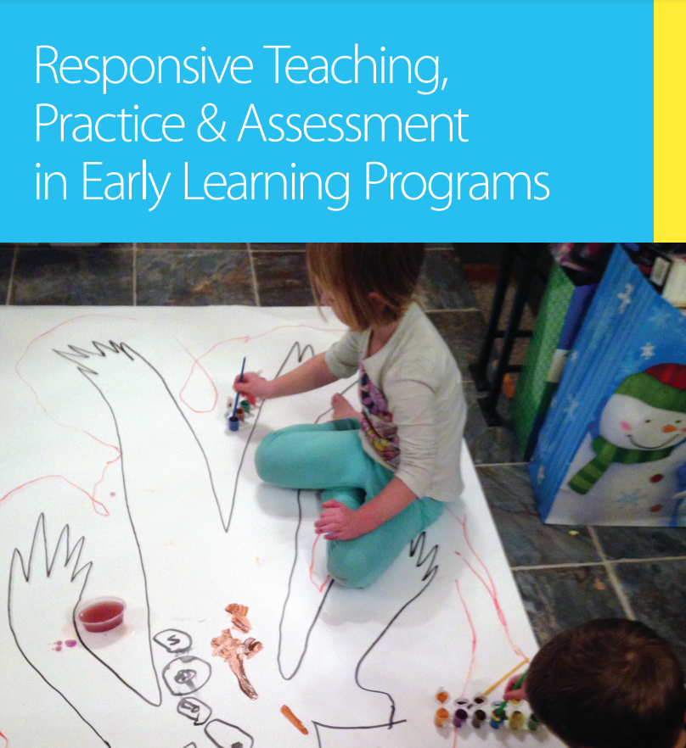
Drivers of Professional
Excellence
Capacity-Building Coaching
Prof. Learning Communities
Collaboration
I belong!
We belong!
Professional Development
Instructional Leadership
Research

Slide 15
Drivers of Professional Excellence
Capacity-Building Coaching
Prof. Learning Communities
Collaboration
I belong!
We belong!
Professional Development
Instructional Leadership
Research

Slide 16
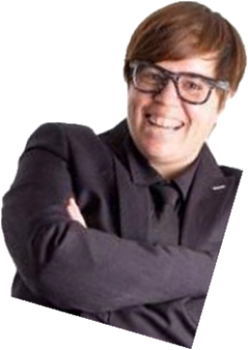
Drivers of Professional Excellence
Capacity-Building Coaching
Prof. Learning Communities
Collaboration
I belong!
June 2021 Virtual Workshop
With Shelley Moore
We belong!
Professional Development
Instructional Leadership
PD Calendar
Research

Slide 17
Drivers of Professional Excellence
Capacity-Building Coaching
Prof. Learning Communities
Collaboration
I belong!
We belong!
Professional Development
Instructional Leadership
Research

Slide 18
Learning and Innovation
Citizenship and Relationships
Focus Areas
SRPSD
Priorities
Engagement – families, SCCs and communities
Volunteerism
Partnerships and connections to global opportunities
Financial literacy
Community education
Student voice
Mental Health and Well-Being
Inclusion and Cultural Responsiveness
SRPSD Strategic Plan
Governance and Leadership

Slide 19
Learning and Innovation
Citizenship and Relationships
Focus Areas
SRPSD
Priorities
First Nations and Métis student success
Truth and Reconciliation Commission’s Calls to Action
Anti-racist and anti-oppressive practices
Partnerships with First Nations communities and leaders
Inclusive learning practices
Support for LGBTQ2S+ community
Mental Health and Well-Being
Inclusion and Cultural Responsiveness
SRPSD Strategic Plan
Governance and Leadership

Slide 20
Learning and Innovation
Citizenship and Relationships
Focus Areas
SRPSD
Priorities
Communication, accountability, and transparency
Fiscal responsibility
Stewardship of resources, technology, and infrastructure
Mental Health and Well-Being
Inclusion and Cultural Responsiveness
SRPSD Strategic Plan
Governance and Leadership

Slide 21
Learning and Innovation
Citizenship and Relationships
Focus Areas
SRPSD
Priorities
Culturally relevant and effective mental health supports
Connections that foster engagement and belonging
Physical activity and wellness
Mental Health and Well-Being
Inclusion and Cultural Responsiveness
SRPSD Strategic Plan
Governance and Leadership

Slide 22
Learning and Innovation
Citizenship and Relationships
Focus Areas
SRPSD
Priorities
Communication, critical thinking and problem solving
Individualized learning in literacy and math
Engagement in Early Learning
Technology and innovation
Innovative learning approaches and alternate pathways to graduation
Mental Health and Well-Being
Inclusion and Cultural Responsiveness
SRPSD Strategic Plan
Governance and Leadership

Slide 23
The Circle
of Courage
Generosity
Belonging
Independence
Mastery

