Slide 1
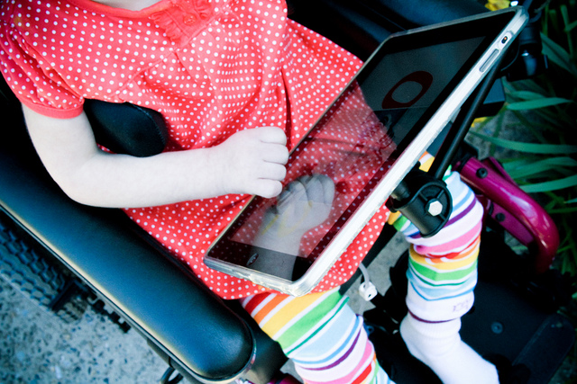
iPad Accessibility Options

Slide 2
iPad Accessibility
Did you know?
  The iPad has built-in accessibility features that support:
    Vision
    Hearing
    Physical & Motor Skills
  There are a number of apps that facilitate access.
  You can use a switch or switches with an iPad.
  All of these accessibility options open possibilities for learning in the classroom.
  Let’s explore…

Slide 3
Video Introduction
Notes:
The “X” on the screen indicates that there is a video embedded in this PowerPoint. Please ensure that you are in Slide Show mode (click on “Slide Show on the top center left of the menu bar, then scroll over to “From Current Slide” to watch the video. Thank you and enjoy!

Slide 4
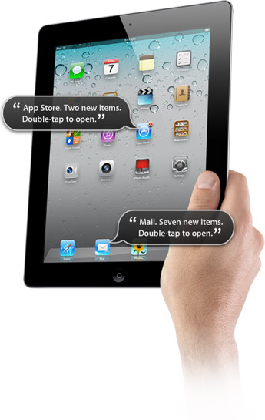
Accessibility Options: Vision
Built into each iPad/iPod there is:
  Voice Over with an adjustable speaking rate & reading options (Roter) .This feature enables students with visual challenges to navigate the screen and open desired programs.
  A speak selection options that enables one to have selected text read aloud. This feature enables students to hear text spoken aloud. For children with visual challenges and/or reading difficulties, this can be a invaluable tool that can be turned on or off as needed.
  Word Prediction features. This feature provides a student with a number of words that are frequently used in response to a user's keystrokes. Word prediction increases the speed of typing and reduces the number of keystrokes required.
  Ability to facilitate wireless Braille displays.
  Zoom, large text & contrast options to enhance visual efficiency.
  Audible alerts that are programmable. Audible alerts can be used to remind students to complete desired tasks and to support efficient transitions.
  For more information, visit: http://www.apple.com/accessibility/ipad/vision.html
When an individual places their finger
over an icon or word, Voice Over reads the word or describes the app aloud. This facilitates navigation of the device for individuals with visual impairments.

Slide 5
Accessibility Options: Hearing
Built into each iPad/iPod there is:
  Facetime: This is ideal for individuals who communicate using sign language or by lip reading. It is also a wonderful tool to facilitate independence. Students can complete a task independently and an adult can employ Facetime to check-in and ask to see what they are doing (i.e. what question they are on, who they are with etc.). In addition, children who struggle to remember longer instructions can quickly Facetime their teacher for a review of the instructions as needed.
  Option for closed captioning.
  A headphone Jack & Bluetooth Audio is available.
  Mono audio features.
  Access to read messages with iMessage – this can be with one or more students/teachers. For example, in the classroom, students can post questions/comments and all students can read or listen to the messages as they appear.
  Programmable visual alerts to remind students to complete tasks and to assist with transitions.
  For more information, visit http://www.apple.com/accessibility/ipad/hearing.html

Slide 6
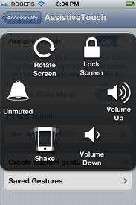
Accessibility Options:
Physical & Motor Skills
Built into each iPad/iPod there is:
  Large multi-touch display
  Assistive touch (see picture) that enables one to complete many functions with one touch (great for individuals with limited dexterity and/or who employ a stylus).
  Tactile buttons
  Onscreen keyboard with word prediction. This makes the iPad highly portable for all students. They do not have to carry an external keyboard to type on the iPad.
  Options for external keyboards and switch access. If a student needs to use a switch or an adapted keyboard to access an iPad – this is an option. In the classroom, this means that like a computer, the iPad can be made accessible for almost all students.
  For more information visit: http://www.apple.com/accessibility/ipad/physical.html

Slide 7
Video Overview of iOS 5 Accessibility Options
Notes:
The “X” on the screen indicates that there is a video embedded in this PowerPoint. Please ensure that you are in Slide Show mode (click on “Slide Show on the top center left of the menu bar, then scroll over to “From Current Slide” to watch the video. Thank you and enjoy!

Slide 8
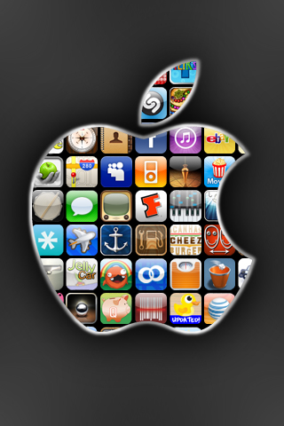
Samples of Apps that Facilitate Access:

Slide 9
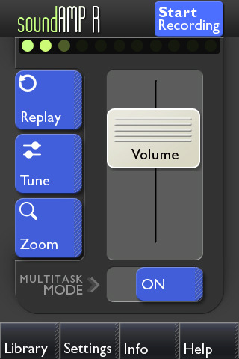
Sampling of Apps that Facilitate Access: Sound Amp R ($4.99)
App that allows you to discreetly amplify and record sounds around you.
This application for iPhone, iPad and iPod touch uses the built-in microphone or headset with mic to amplify nearby sound. You can adjust volume, tone, and background sound levels and make recordings.
In the classroom, one can use this app to record students reading and then listen to their recordings as time permits.
SLPs & Classroom Teachers have found the app useful as you can amplify high frequency sounds (e.g. sounds like s, f, th). Therefore, in the classroom, this app may be used to increased students’ awareness of sounds, provide opportunities for sound play and practice producing targeted sounds.

Slide 10

Sampling of Apps that Facilitate Access: Sign 4 Me ($9.99)
American Sign Language (ASL) Translator.
Using this app, one can control a 3D animated character that demonstrates ASL with a library of over 11,500 words.
Just type a sentence, word, or phrase to see it signed.
In the classroom, this can assist all adults and children in exploring and learning sign language. It is an efficient sign interpreter that is easily accessible.
Notes:
The “X” on the screen indicates that there is a video embedded in this PowerPoint. Please ensure that you are in Slide Show mode (click on “Slide Show on the top center left of the menu bar, then scroll over to “From Current Slide” to watch the video. Thank you and enjoy!

Slide 11

Sampling of Apps that Facilitate Access: Digit Eyes ($29.99)
Digit-Eyes enables people without vision to read barcode labels (e.g. can facilitate identification of labeled contents in a can).
Specifically, it enables individuals to use their iPhone/iPad to scan UPC/EAN codes & then hear the names of over 7.5 million products.
One can also print barcodes from the Digit-Eyes website on ordinary labels to ease further identification of objects.
In school, for life skills programming, this app may enable students with visual challenges to identify objects, efficiently sort objects and support their ability to utilize materials appropriately without additional labeling systems being prepared by staff.
Notes:
The “X” on the screen indicates that there is a video embedded in this PowerPoint. Please ensure that you are in Slide Show mode (click on “Slide Show on the top center left of the menu bar, then scroll over to “From Current Slide” to watch the video. Thank you and enjoy!

Slide 12
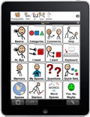
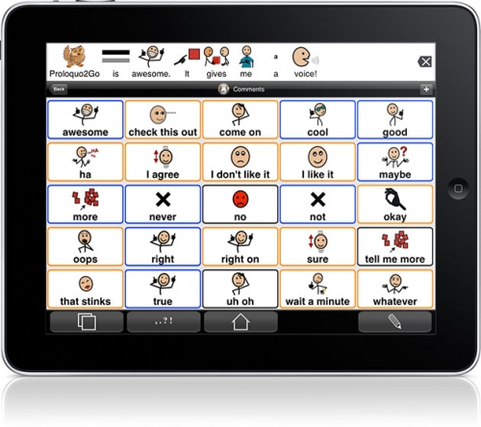
Sampling of Apps that Facilitate Access: Proloquo2Go ($189.99)
Proloquo2Go™ is a full-featured communication solution for people who have difficulty speaking. It brings natural sounding text-to-speech voices to close to 8000 symbols, to the iPhone, iPod touch and iPad.
In the classroom, this is a user-friendly app that can be used for all young learners as they begin to read and write sentences. The pairing of words with pictures and sounds provides a multi-modal system to support learning and literacy.
For students with communication challenges, the app provides easy access for all communication partners. It supports conversations with peers/adults with minimal, if any, specialized training being required.
For staff, the iPad’s built-in camera makes it easy for students and adults to quickly add real photos from their classroom environment. No longer do staff need to take pictures, download them to the computer, transfer to the AAC device and program.

Slide 13

Sampling of Apps that Facilitate Access: Read2Go (Cost: 19.99)
Read2Go is an accessible DAISY book ereader for iOS. In the classroom, this app will enable students to efficiently have books & text read aloud to them w/out additional prep work.
From within the app, you can browse, search, download, and read books directly from Bookshare using your Bookshare membership (qualifying individuals include those with visual impairment, physical, learning and/or reading disabilities), or read DAISY books from other sources.
The app gives you full control over visual choices for font size and color, background and highlighting color, and text-to-speech preferences.
Read2Go features word-by-word highlighting for multi-modal reading.
For more information on Bookshare, please visit http://www.bookshare.org/home?c=ca
Notes:
The “X” on the screen indicates that there is a video embedded in this PowerPoint. Please ensure that you are in Slide Show mode (click on “Slide Show on the top center left of the menu bar, then scroll over to “From Current Slide” to watch the video. Thank you and enjoy!

Slide 14

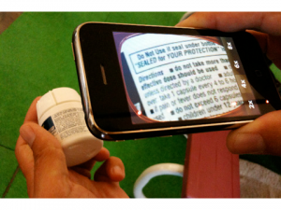
Sampling of Apps that Facilitate Access: Eyeglasses (Cost: $2.99)
Eyeglasses App
  This app offers 2X, 4X, 6X or 8X magnification levels using the iPhone/iPad autofocusing camera. Simply hold the camera 5 inches from the object you wish to examine to display text or imagery. Ideal for anyone who has trouble reading fine print or needs to see in greater detail, this app is suited for everyday use and for emergencies that require clarity of vision.
  In the classroom:
    This app can support students with visual challenges to have portable access to screen magnification as needed.
    With connection to a projector, this app can also be used as a document camera and enlarge materials for all students to see.

Slide 15

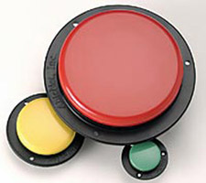
Switches help individuals with physical challenges to learn about cause-and-effect, timing, and helps them operate and control computers or other devices.

Slide 16
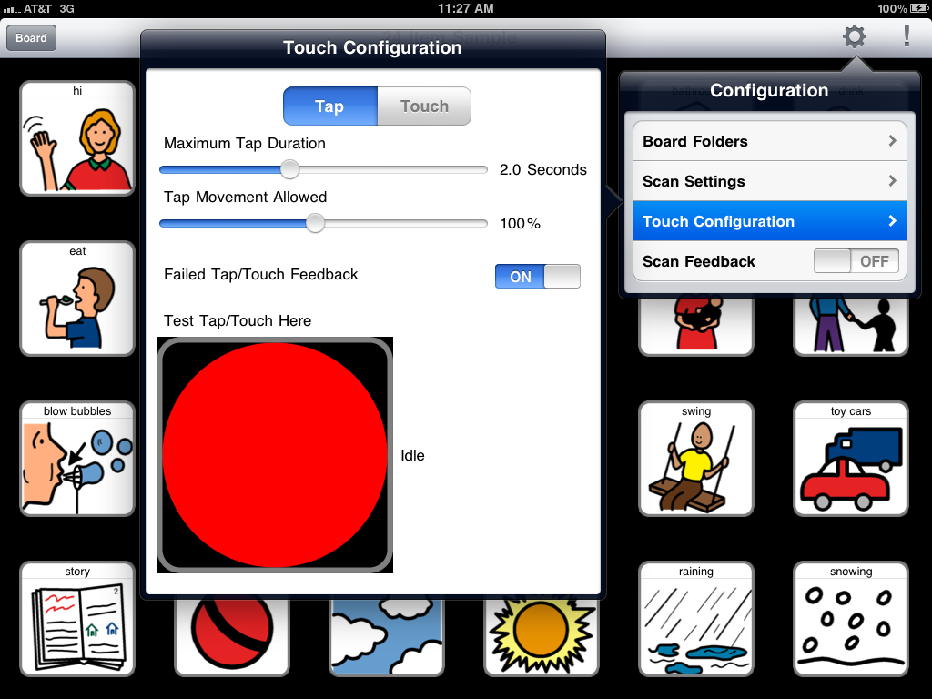
Did you know that iPads & iPods can be used as switches & accessed with a switch?

Slide 17
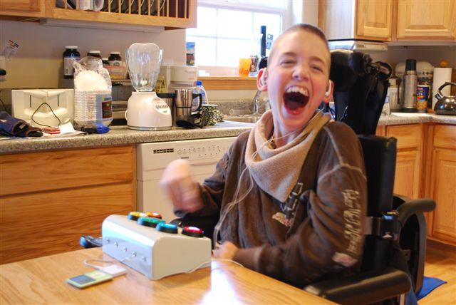
Switch Access & iPod
RJ Cooper’s Big Button iPod Remote: In this picture, one can see a device that enables a student with fine motor challenges to independently select, play, stop and adjust the volume on an iPod.

Slide 18
Switch Access & iPads
These videos show ways that 1 or 2 switches can be used with the augmentative communication apps TapToTalk (left) and Soundingboard 2 (right).
Example of single-switch scanning (RJ Cooper)
Example of dual switch scanning (Ablenet)
Notes:
The “Xs” on the screen indicate that there are videos embedded in this PowerPoint. Please ensure that you are in Slide Show mode (click on “Slide Show on the top center left of the menu bar, then scroll over to “From Current Slide” to watch the video. Thank you and enjoy!

Slide 19
Or, alternatively, there are apps that turn the whole iPad into a switch:
Tap Speak ($14.99)
In the classroom, one can use this app to enable students who use a switch to: greet peers; use for games such as “you can’t catch me”; request “more”, “help” or “I need a break”; record answers in class; announce transitions; record repeated words or phrases in a story or record messages between home and school.
What is great about this app is that you can save multiple messages and not need to re-record over old messages.
Tap Speak Sequence ($29.99)
With this app, one can use the switch to: gain other people’s attention (e.g. “come over here”, “I want to talk to you”); start a race in gym class (“ready”, “set”, “go!”); practice the letters of the alphabet; practice spelling one’s name; read the news to peers; recite a poem or story; take part in a oral presentation in class; tell jokes to peers; take part in a structured conversation; give messages between peers; adults, home/school; order a meal in a restaurant; make purchases in a shop; or give instructions to the class.
Notes:
The “Xs” on the screen indicate that there are videos embedded in this PowerPoint. Please ensure that you are in Slide Show mode (click on “Slide Show on the top center left of the menu bar, then scroll over to “From Current Slide” to watch the video. Thank you and enjoy!

Slide 20
Apps that turn the whole iPad into a switch:
Tap Speak Choice
Notes:
The “X” on the screen indicates that there is a video embedded in this PowerPoint. Please ensure that you are in Slide Show mode (click on “Slide Show on the top center left of the menu bar, then scroll over to “From Current Slide” to watch the video. Thank you and enjoy!

Slide 21
What about individuals who need a text-to-speech AAC Device?
PredictAble App
For students who can read and write and need a voice output device for writing support or as a communication device – Predictable may be an option. Predictable is a text-to-speech app that enables users to use direct access, multiple or single switch access with or without scanning, to communicate. For efficiency, this app has word prediction capabilities and enables storage of commonly used phrases . With this app, one can communicate, type responses and send emails, message peers, and update your facebook status etc.
Notes:
The “X” on the screen indicates that there is a video embedded in this PowerPoint. Please ensure that you are in Slide Show mode (click on “Slide Show on the top center left of the menu bar, then scroll over to “From Current Slide” to watch the video. Thank you and enjoy!

Slide 22
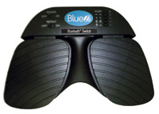

Accessibility Options:
Switch Interfaces
To use a switch with an iPad, one would need an interface. Two options that are presently
include the following:
Ablenet’s Blue2 Wireless Switch Interface ($149.00)
RJ Cooper’s Bluetooth Switch Interface ($99.00)

Slide 23
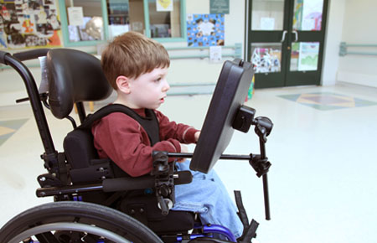
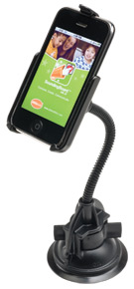
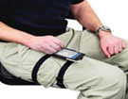

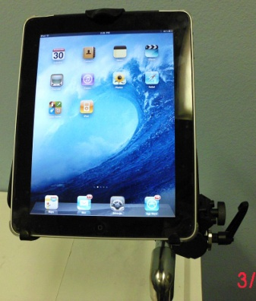
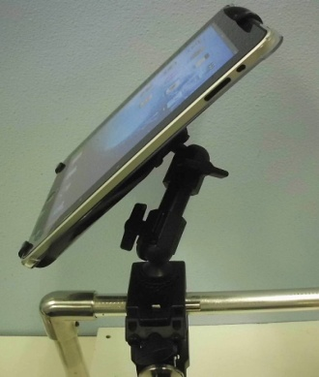
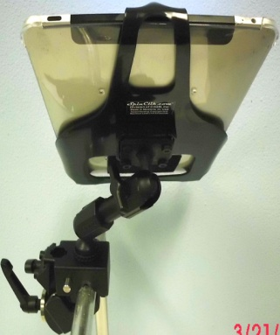
To facilitate use of the iPad in multiple environments, a number of mounting options are now available.
Here is a sample of the possibilities:

Slide 24
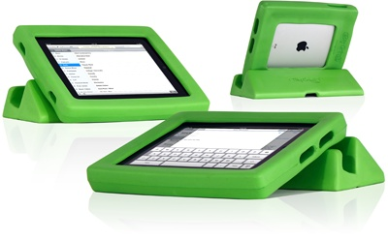
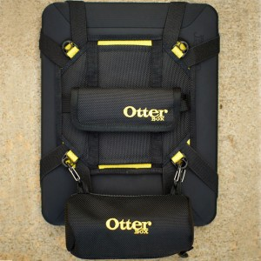
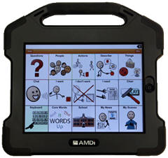
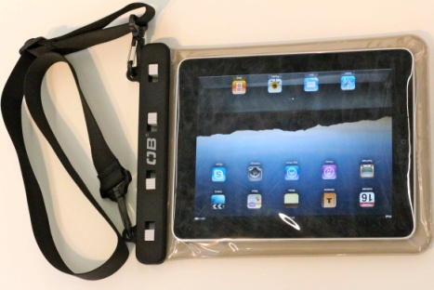
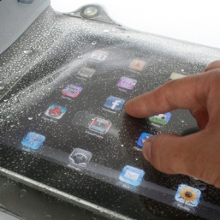
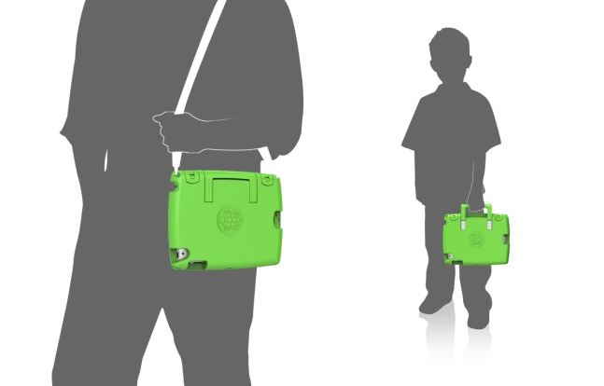
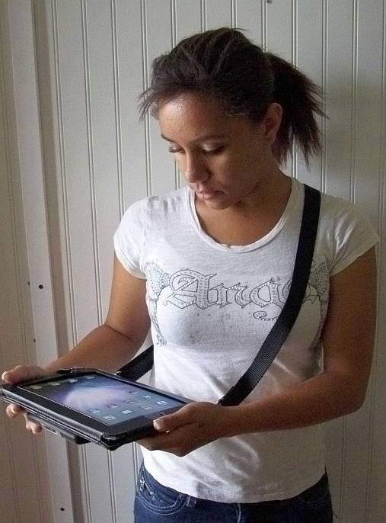
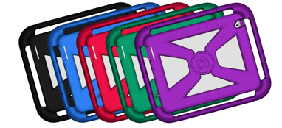
With students, a frequent concern is iPad Protection – especially during transitions. To assist, a number of options are now available. Here is a sample of possibilities available:
Big Grips – available through www.adorama.com
Otterbox
iAdapter
Trtlbot Case
Gripcase
RJ Cooper iPad Carrying Case

Slide 25
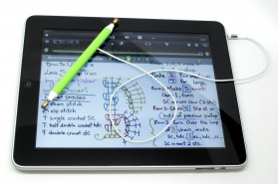
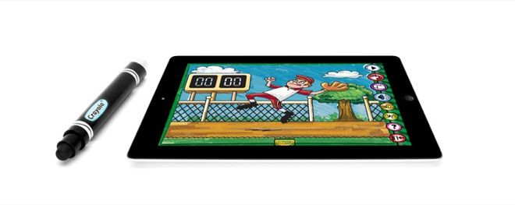

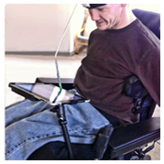
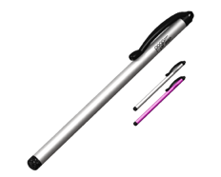
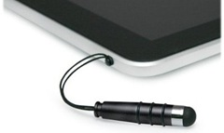
For many students with fine motor challenges, the touch screen can be tricky. For some students a commercial or custom stylus may be an option. Here are some options that are presently available:
Crayola iMarker –
Kid-Friendly Stylus
Doceri Goodpoint Stylus
Boxwave Capacitive mini stylus – Attaches to idevice when not in use.
Pogo Sketch Stylus
Head-mounted stylus

Slide 26

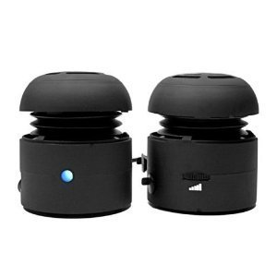
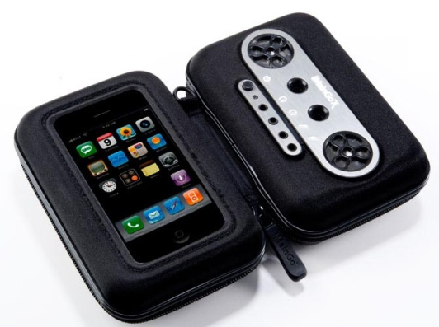
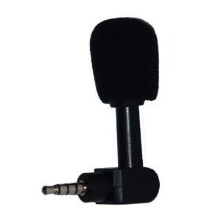
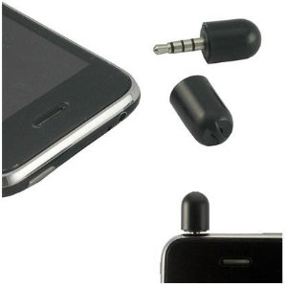
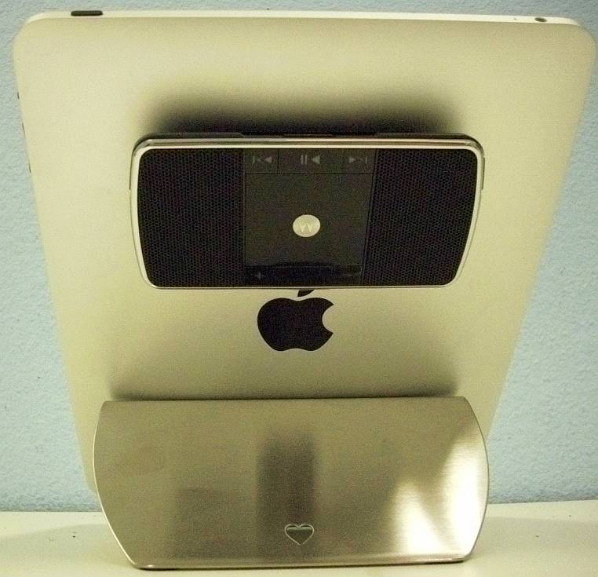
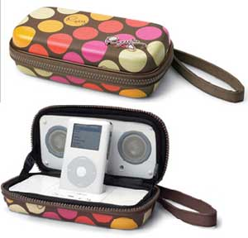
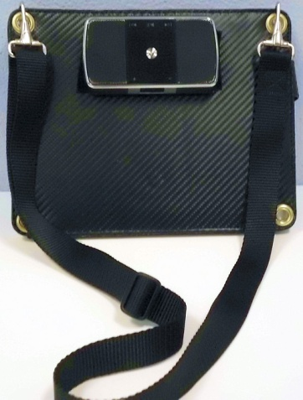
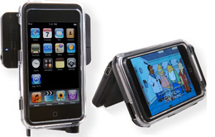
To optimize sound quality when using the iPad/iPod to record or produce sound, a number of speakers and microphones are now available. Here is a sample of options:
VeriCorder: MiniMic
Chill Pill Mobile Speakers
iMainGo Portable Speakers
Mini Mic
Roxy Portable
iPod Speakers
RJ Cooper iPad
Speakers
Livespeakrs

Slide 27
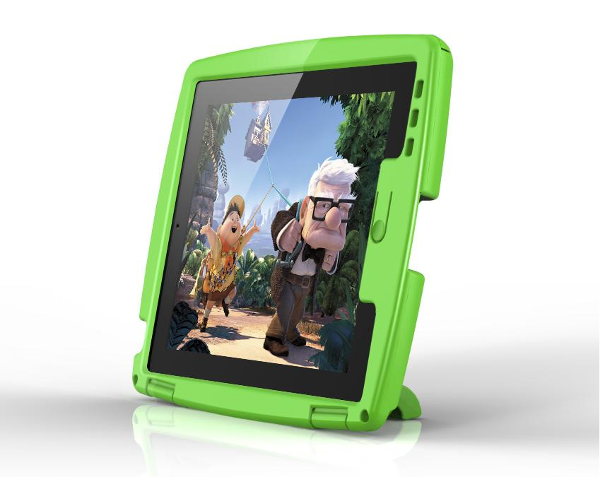
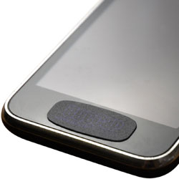
For some students, it can be helpful to cover the home button. To assist, two options are available:
Trtlbot Case – A case that covers the home button.
Bubcaps – Stickers that make it challenging for kids to access the home button.
Notes:
The “X” on the screen indicates that there is a video embedded in this PowerPoint. Please ensure that you are in Slide Show mode (click on “Slide Show on the top center left of the menu bar, then scroll over to “From Current Slide” to watch the video. Thank you and enjoy!

Slide 28
Technology is truly the great equalizer!
Thank you for reviewing this presentation on iPad accessibility.
We look forward to hearing from you on how you are using iTechnologies to engage, meet learning needs and foster independence for students.
  Please email your experiences and strategies to the email below. We would like to post your experiences to share resources, ideas and practical experiences with others across the province.
In addition, if you have any further questions/comments, please do not hesitate to phone or email:
  Louise Burridge: 1-306-787-0561
  Email: lburridge@gov.sk.ca

