Slide 1
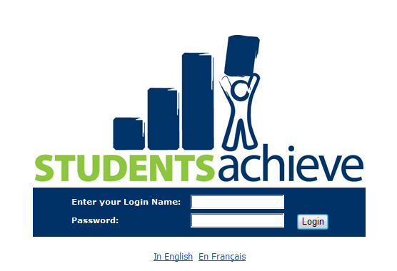
Assessment Grade Book Software
A.K.A.: The New Report Card
Notes:
Students Achieve is the name of the assessment and evaluation software that SRSD has purchased. It is a division of SRB, a company which owns L4U our library system and our human resources and payroll computer programs as well. Students Achieve integrates well with Maplewood, our student data system, and this was one reason it was chosen.

Slide 2
Contents
This presentation has introductory material covering
  How to find the Students Achieve Software
  Basic steps in creating an Assignment in the grade book.
  The concept of how a grade book is tied to a report card.
Notes:
This presentation is designed for school staff members about to use Students Achieve software for the first time, or for schools interested in knowing what this software is about.
Complete training materials are available online and in person through the Integrated Learning Department.

Slide 3
Why a change now?
Assessment practices are changing, this software is customizable to fit our school division needs.
Elementary teachers have been requesting the option of using an electronic grade book – this one supports outcome based assessment
Our current report card is no longer supported by it’s creator (retired). So although it still works, it’s no longer very customizable.

Slide 4
Students Achieve is tied to Maplewood
Classes are already created for you
  If a class is missing, school secretaries can make changes in Maplewood which will be reflected in SA the next morning.
  New students and outgoing students are also handled the same way.
Attendance can be done from your SA screen

Slide 5

Logging On
It is Web-Based.
SRSD>Staff Room
>Staff Bulletin Board
you will see this icon:
You can access this from any computer, home or work
It takes your regular SRSD username and password
NOT your email address, your username
Notes:
Your first interaction with Students Achieve will be finding the program online, and hopefully creating a shortcut to it on your desktop so that it is readily available to you on a daily basis.

Slide 6
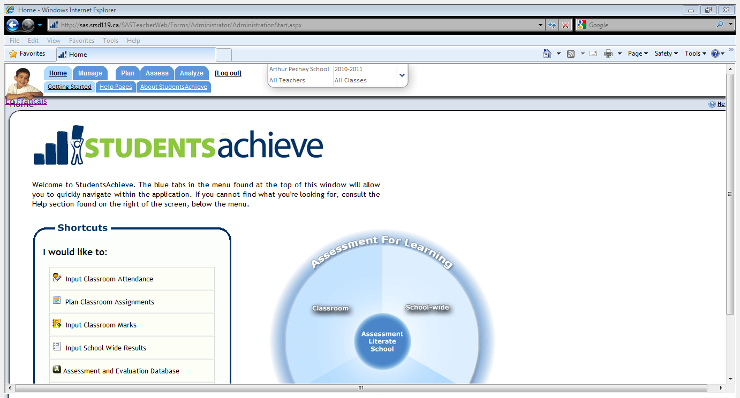
I
Notes:
This is what the welcome screen looks like.
There is a menu along the top, you can navigate anywhere that way, or, use the shortcuts mid page to quickly jump to most often used items. I use the shortcuts list 90% of the time.

Slide 7
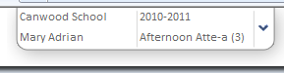
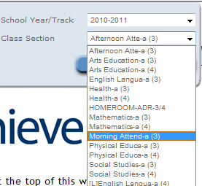
1.)
2
Notes:
The first step is to choose the class you want to enter an assignment for. Clicking the small drop down arrow at the top of the screen will bring up a list of all your Maplewood courses for you to choose from.
If a class is missing, school secretaries can make changes in aplewood which will be reflected in SA the next morning.

Slide 8
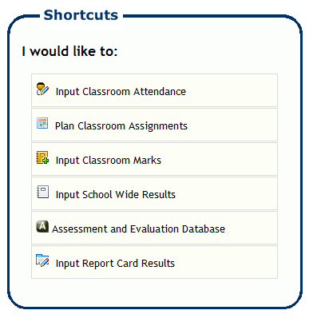
Plan Assignment
Step one:
Enter an assignment
(it will allow you to choose
the outcomes you wish to assess.)
Notes:
Now you are ready to plan a classroom assignment. Choose this option from the shortcut screen Or from the Plan tab in the top menu choose classroom, then assignments.

Slide 9
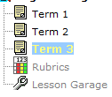
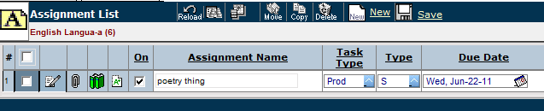
Choose Term,
Click New.
Notes:
C

Slide 10
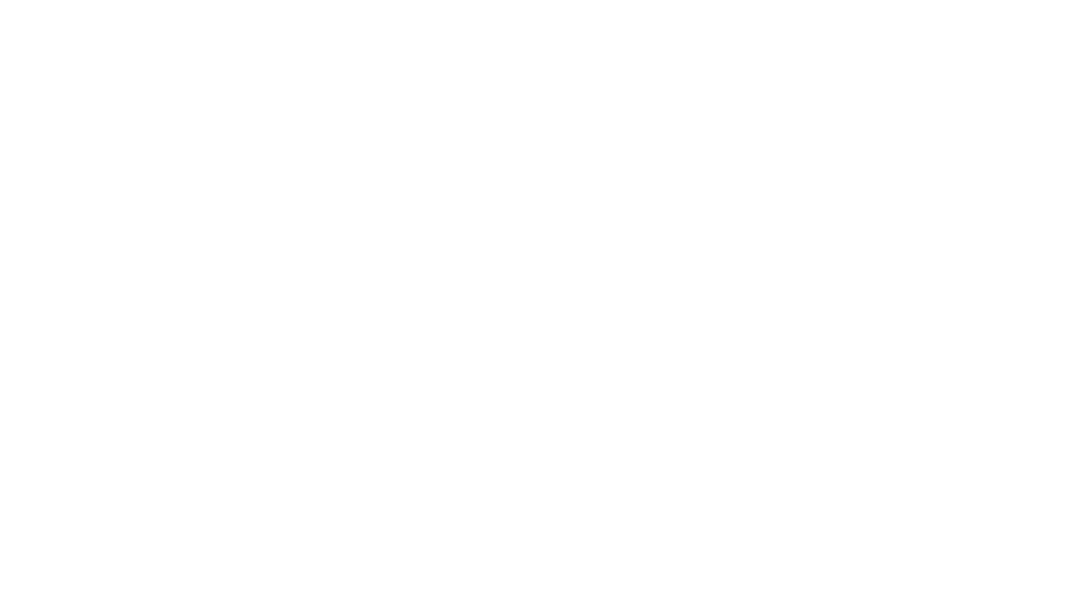
Video of Planning a Grade 7 ELA assignment

Slide 11
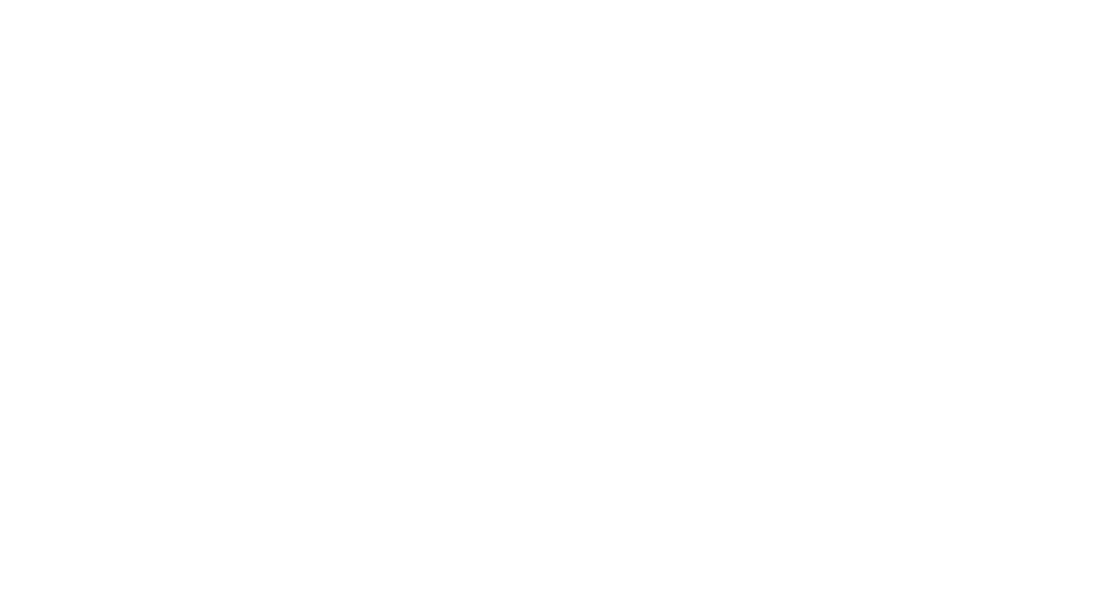
Video of Entering Marks

Slide 12
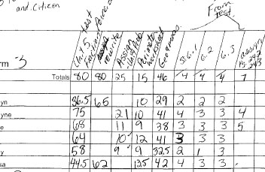
What can I do now?
Notes:
Move to

Slide 13
Assessment Grade Book Software
Start where you are: NOW☺
Notes:
Don’t wait

